Slide 1

Collaborate, Share & Grow Together
Team ‘Tech Womaniya’
Jun 2020

Slide 2

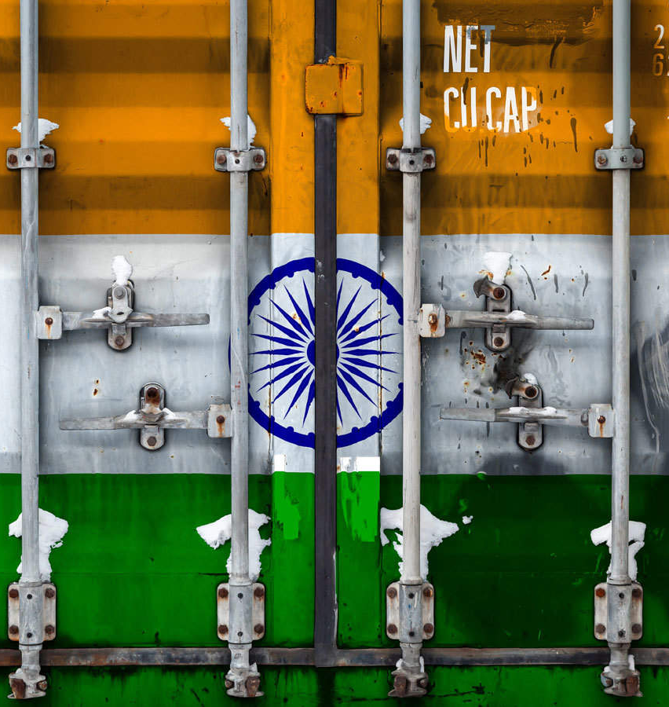

INTRODUCTION
The Covid-19 pandemic has left its impact on all sectors of the economy but nowhere is the hurt as much as the Medium, Small and Micro Enterprises (MSMEs) of India.

Slide 3

EXTEND OF IMPACT
shrinkage of exports,
cessation of production,
Import of raw material taking hit,
non-availability of manpower,
the uncertainty of consumption,
liquidity squeeze in the market
etc...

Slide 4

Why MSMES ?
There are 6.34 crore MSMEs in the country that provide employment to more than 114 million and contribute around 35 percent to the GDP. But today, this ever-struggling but promising sector, has got a question mark raised on its very existence amid the lockdown, primarily because these are not firms that have too much cash to wait out the crisis.

Slide 5
We strongly advocate that collaboration between MSMEs and technology are the way forward for the industry to fight and emerge stronger amid this pandemic.
The current situation can become a change accelerator for this sector if, steered in correct direction. Thus, presenting a B-to-B networking platform, ‘MSME Sutra’.
A Bridge From Adversity to Prosperity

Slide 6
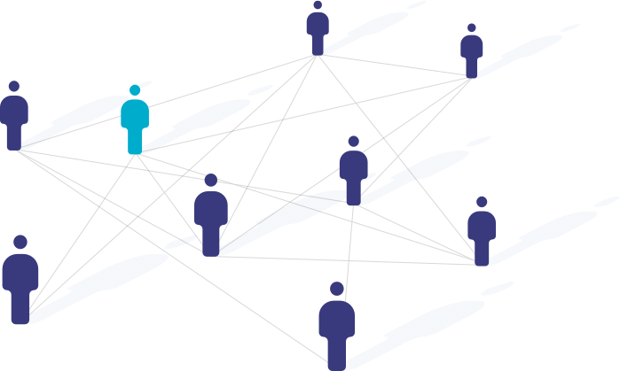

MSME SUTRA – PROPOSED solution
This platform offers an opportunity to link businesses digitally, allowing them to harness a collective pool of resources, the 3Ms – Men, Machinery & Materials.

Slide 7

MSME SUTRA – PROPOSED solution
Apart from helping these enterprises in this period of turmoil, this portal would help expand customer base for these limited scaled industries.
Also, would offer a chance to take business growth to the next level because no dreams are Micro-Small-Medium - so why should Enterprises be?

Slide 8
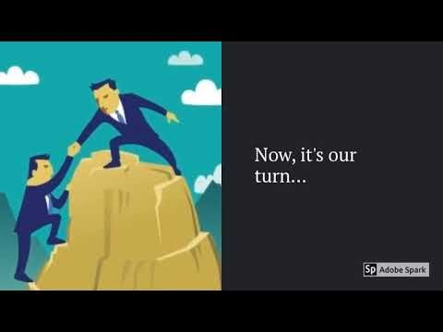
MSME SUTRA – Portal Demo
Link to Portal: https://techwomaniya6.wixsite.com/msmesutra
Link to Demo: https://www.youtube.com/watch?v=CJsobfaN5BI

Slide 9
What makes us different?
We believe that winners don’t do different things. They do things differently. The same ideology is followed while developing MSME Sutra.
This platform links indigenous industries to meet supply and demand, thus kickstarting the production for these halted industries.
It is dedicated towards initiating meaningful connections & dialogues among various MSMEs, so that they can maintain a symbiotic relationship in this challenging time to keep themselves afloat.
Bharat Ko De Atma Nirbharta

Slide 10

Ek idea jo badal de duniya
‘MSME Sutra’ is not just about supporting small businesses. It supports dreams, innovation, job creation and in turn, a great nation.
Given the time constraints, we tried our best to create a prototype of our idea, an idea that speaks for itself! But given adequate resources & support, we would love to convert it to a reality. We surely have a pool of thoughts that would leave an ever-lasting dent in this sphere and make the journey of aspiration to achievement easier…

Slide 11

FUTURE ROADMAP
Connect MSMEs digitally so that they can satisfy supply & demand chain without importing from other nations, thus, strengthening the very ideology of ‘Make In India’ & ‘Atma Nirbhar Bharat’.
Create network of Labour unions through this portal at national level, so as to satisfy the manpower requirements without inter-state labour migration.
More than 99% of MSMEs are of micro nature. With this platform, we are aiming to increase the percentage of small and medium size industries by encouraging collaborations & mergers among various micro size industries, thus, giving birth to more employment opportunities and adding to GDP. – ‘Start Up India, Stand Up India’

Slide 12

FUTURE ROADMAP
Aim to create a knowledge section/pool of investment ideas that would act as a catalyst in creation of new entrepreneurial projects.
Maintain a central repository of nationwide MSMEs for enhanced business operations.
Use Data Analytics to study market patterns in terms of geography, raw materials, type of industries etc..
Provide an interface where buyer & seller could come together and discuss terms at their own pace through a Chat Bot link IBM Watson.
Connect small businesses to e-commerce giants for expanding growth & profits focusing PM’s ‘Vocal For Local’ initiative.
Collaborate with government to promote and encourage initiatives like ‘Solar Charkha Mission’, ‘MSME Sambandh’, ‘Udyam Sangam’ etc..

Slide 13

Vision A bridge from Micro → MEDIUM
COVID19 is presently a mammoth negative event for India and the Indian economy, but we strongly believe that it will definitely generate equally strong opposite positive reactions that would bring long lasting changes never imagined hitherto.
If steered in right direction, this pandemic would become a change accelerator. ‘MSME Sutra’ will go a long way from COVID induced measures to strengthening of this ever-struggling sector.
We, Tech Womaniya, strongly believe in the pioneering spirit of these businesses and will work to bridge the gap between their aspirations & achievements.

Slide 14


